Slide 1
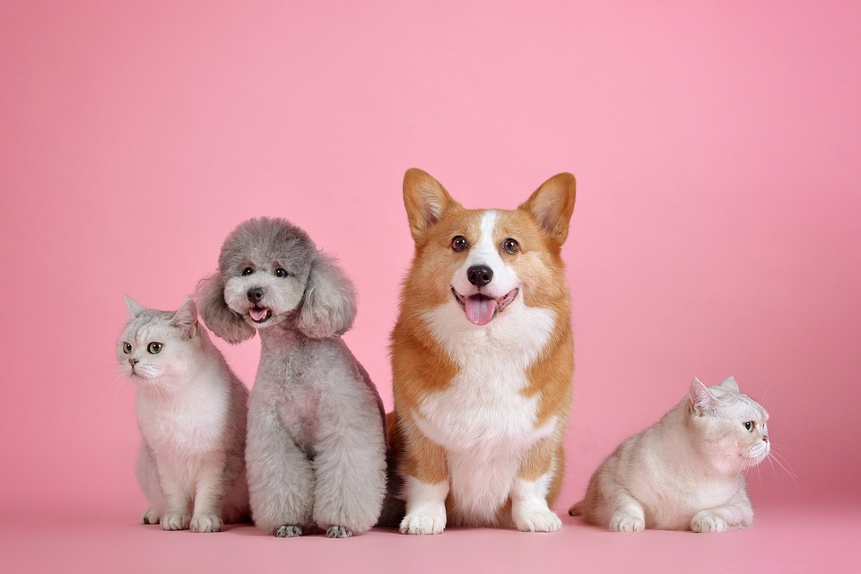
VET database
group project
By Marianne Wells, Sophie Alderson and Ildiko Wurth

Slide 2
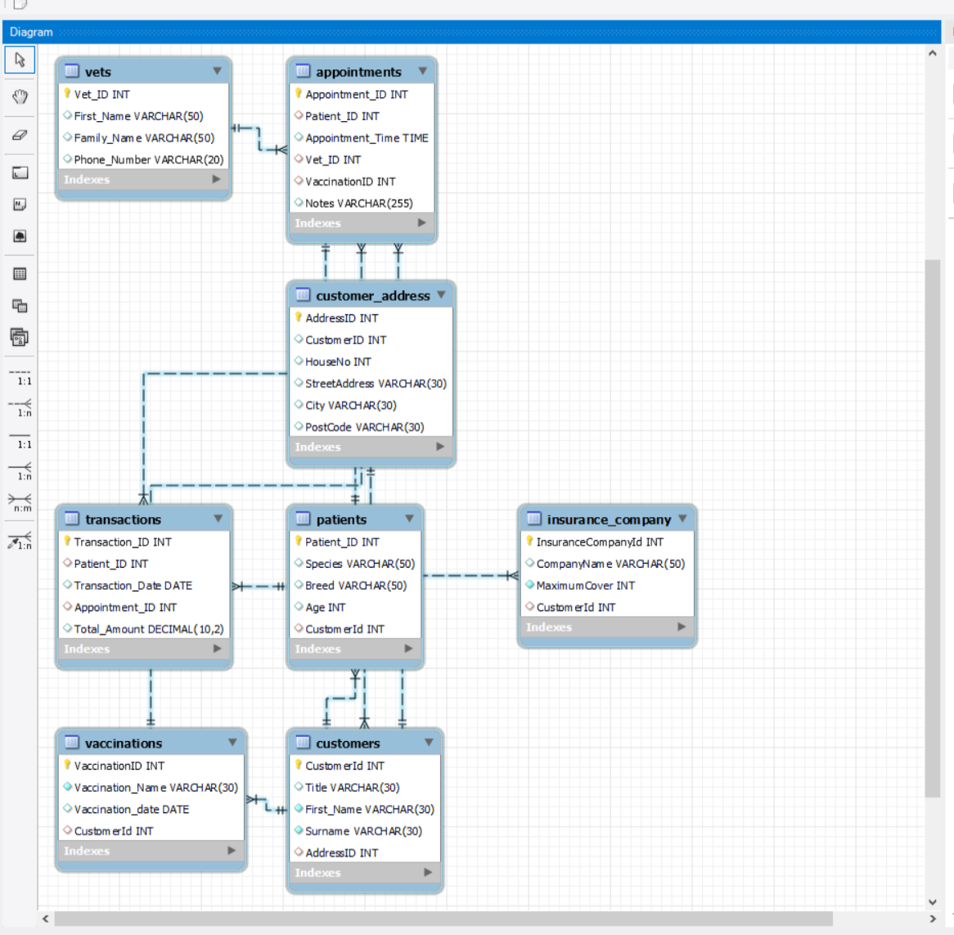
DB diagramm

Slide 3
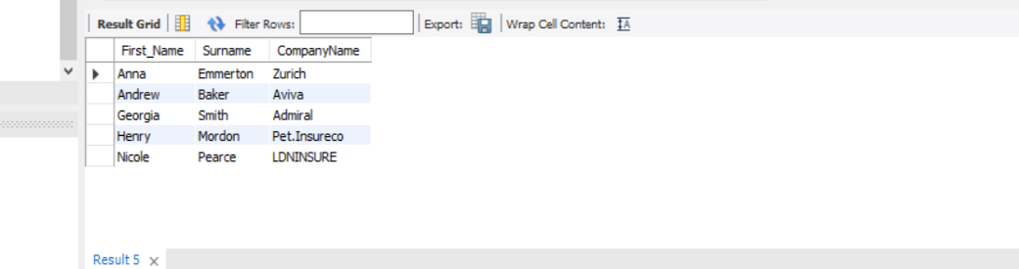
Inner Join - Marianne
USE VetProject;
SELECT Customers.First_Name, Customers.Surname, Insurance_Company.CompanyName FROM Customers INNER JOIN Insurance_Company ON
Customers.CustomerID = Insurance_Company.CustomerID;

Slide 4
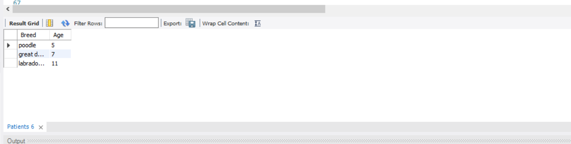
Subquery- Marianne
USE VetProject;
SELECT Breed, Age FROM Patients GROUP BY Patient_ID HAVING Max(Age)>4 ORDER BY AGE ASC;

Slide 5
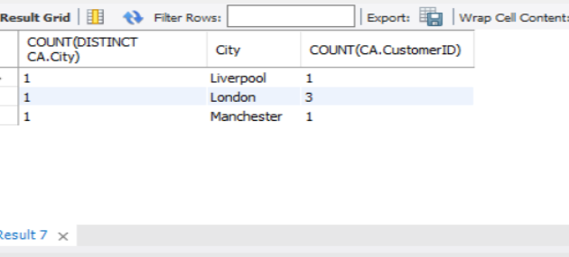
Group By -Marianne
USE VetProject;
SELECT COUNT(DISTINCT CA.City), CA.City, COUNT(CA.CustomerID)
FROM Customer_Address AS CA GROUP BY CA.City;

Slide 6
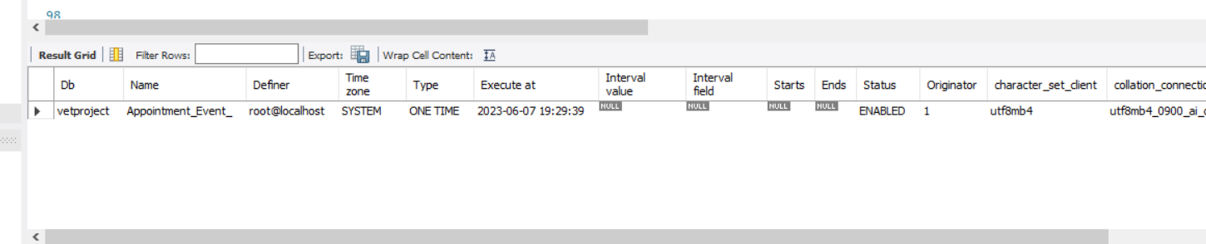
Create an Event - Sophie
Use vetproject;
CREATE EVENT Appointment_Event_
ON SCHEDULE AT CURRENT_TIMESTAMP + INTERVAL 1 MINUTE
DO
UPDATE Appointments SET Appointment_Time = Appointment_Time + 1;

Slide 7
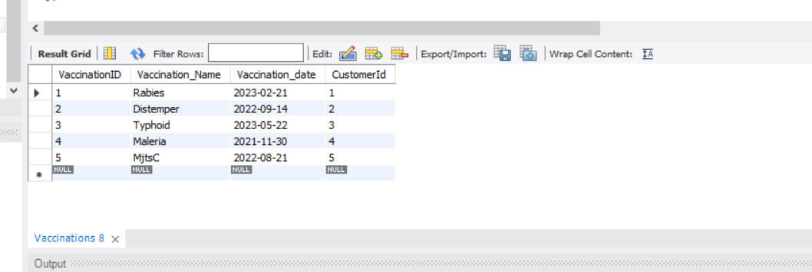
Create a Trigger -Sophie
DELIMITER //
CREATE TRIGGER NEW_DATE_Vaccinations
BEFORE INSERT on Vaccinations
FOR EACH ROW
BEGIN
SET NEW.Vaccination_date = CONCAT(UPPER(SUBSTRING(NEW.Vaccination_date, 1, 1)), LOWER(SUBSTRING(NEW.Vaccination_date FROM 2)));
END //
DELIMITER ;
INSERT INTO Vaccinations (VaccinationID, Vaccination_Name, Vaccination_date, CustomerId)
VALUES(11, 'Rabies', '2023-02-21', 1);
INSERT INTO Vaccinations (VaccinationID, Vaccination_Name, Vaccination_date, CustomerId)
VALUES(12, 'Distemper', '2022-09-14', 2);
INSERT INTO Vaccinations (VaccinationID, Vaccination_Name, Vaccination_date, CustomerId)
VALUES(13, 'Typhoid', '2023-05-22', 3);
SELECT *
FROM VetProject.Vaccinations;

Slide 8
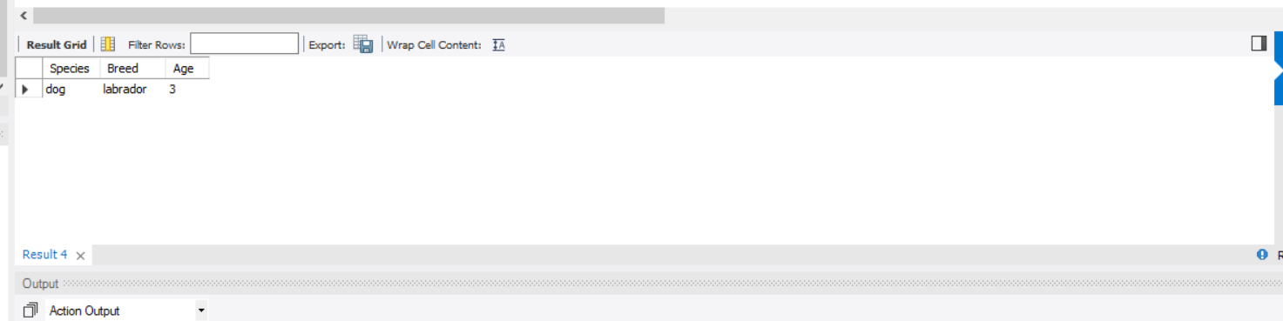
Stored Procedure- Ildiko
USE VetProject;
DELIMITER //
CREATE PROCEDURE GetCustomerPets( p_CustomerId INT)
BEGIN
SELECT Patients.Species, Patients.Breed, Patients.Age
FROM Patients
WHERE Patients.CustomerId = p_CustomerId;
END;
//
DELIMITER ;
CALL GetCustomerPets(1);

Slide 9
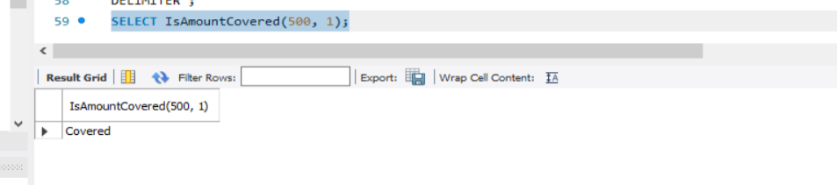
Stored Function-Ildiko
USE VetProject;
DELIMITER //
CREATE FUNCTION IsAmountCovered( p_Amount Integer, p_InsuranceId INT) RETURNS VARCHAR(10) DETERMINISTIC
BEGIN
DECLARE maxCover integer;
SELECT MaximumCover INTO maxCover
FROM Insurance_Company
WHERE InsuranceCompanyId = p_InsuranceId;
IF p_Amount <= maxCover THEN
RETURN 'Covered';
ELSE
RETURN 'Not Covered';
END IF;
END;
//
DELIMITER ;
SELECT IsAmountCovered(500, 1);

Slide 10
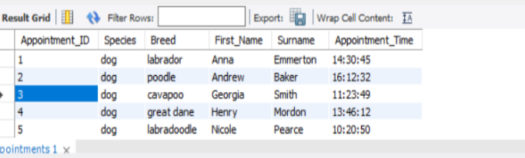
Create a View- Ildiko
CREATE VIEW VetAppointments AS
SELECT Appointments.Appointment_ID, Patients.Species, Patients.Breed, Customers.First_Name, Customers.Surname, Appointments.Appointment_Time
FROM Appointments
INNER JOIN Patients ON Appointments.Patient_ID = Patients.Patient_ID
INNER JOIN Customers ON Patients.CustomerId = Customers.CustomerId;
SELECT * FROM VetAppointments;
select VetAppointments.Surname from vetappointments where VetAppointments.Species = 'dog';

